Slide 1
Chapter 17: Enhancing Presentations With Slides and Other Visuals
Book: Business Communication Today (14ed.)
Authors: Bovee, Thill and Raina

Slide 2
Structured Slides
They follow the same basic format throughout the presentation.
Based directly on the templates built in PowerPoint.
Feature bullet points.

Slide 3
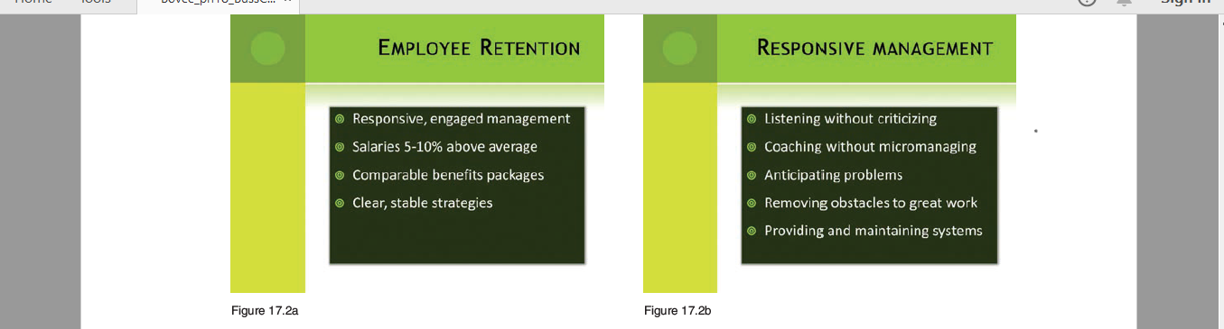

Slide 4
Advantages of Structured Slides
Easy to create by choosing an overall design scheme for the presentation.
Less time taking.
A more practical choice.
More information can be packed onto each slide.
More effective in conveying complex ideas or sets of interrelated data.

Slide 5
Disadvantages
Creates a mind-numbing effect of text-heavy slides that all look alike.
Less audience attention.

Slide 6

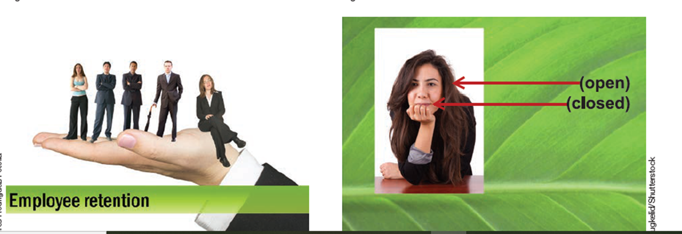
Free Form Slides

Slide 7
Free-Form Slides
They don’t follow a rigid structure.
But one cannot change design randomly.
Unification through design elements such as colour, typeface etc.
Complementary approach of visuals and words is a highlight of free-form design.

Slide 8
Advantages
Such slides provide both visual and textual information.
They prevent cognitive overload by limiting the amount of information delivered at any one time.
Helping viewers process information by identifying priorities and connections. For instance, by highlighting important data points on a graph.
Appropriate imagery and thoughtful design create a more dynamic and engaging experience for audience.
Such slides are good for motivational, educational and persuasive purposes. Particularly when they will be used multiple times they will compensate for the extra time employed to create them.

Slide 9
Disadvantages
Designing slides with visuals and textual elements is more creatively demanding and time consuming.
With less textual information on slides, the speaker is responsible for conveying more of the content.
If not handled carefully, division of content into smaller chunks can make it difficult to present complex subjects in a cohesive and integrated manner.

Slide 10
Designing Effective Slides
Presentation software is just a tool and can be used properly and poorly.
A presentation should not be dull and slide heavy as it will make it difficult for audience to understand. “Death by Power Point”
A reason for ineffective slides is treating them as stand alone documents, that can be read without a presenter. Such “slideuments” are ineffective.
Create an effective slide set and a separate handout for detail and supporting information.

Slide 11
5. Another alternative is to use notes field in your presentation software for speaking notes for each slide.
6. But if a slideument is your only option, then be clear and simple. Do not overload slides. As having a large number of simpler slides is better than a small number of complex slides.
Notes:
gffd

Slide 12
Design Elements
1. Colour
2. Artwork
3. Typeface/ Type Style

Slide 13
1. Colour
Colour is very crucial, it is far more than decoration.
It grabs attention, emphasize importance and establishes contrast.
It increases overall acceptance of your message by 60%.
It increases willingness to read by 80%.
Enhance learning and improves retention by 75 %.

Slide 14
Emotions:
Excite audience---- Red and orange
Relaxed environment------ Blue
Colours can have different meanings in different cultures.
Selecting Colours for Background and Text:
When presenting in a dark room use dark background with light colour text.
When presenting in a well-lit room use light background with dark colour text.

Slide 15
2. Artwork
Slide
Background
Foreground
(Text + Graphic Elements)

Slide 16
The less a background does, the better.
It should not be flashy and cluttered.
It should stay at the background and must not compete with the foreground.
Use solid colours.
In the background all artwork is decorative.
In the foreground artwork can either be functional or decorative.

Slide 17
Functional Artwork
Images that are part of your message.
Decorative Artwork
Does not deliver textual information.
May or may not be helpful.
Diverts attention, least important, often causes trouble.

Slide 18
3. Typeface/ Type Style
Avoid decorative typefaces or use them carefully. For Example, TYPEFACE/TYPE STYLE.
Limit the number of typefaces to one or two per slide.
When using thinner typefaces, use boldface so that they don’t disappear when displayed on screen.
Avoid most italicized type, it is difficult to read when projected.

Slide 19
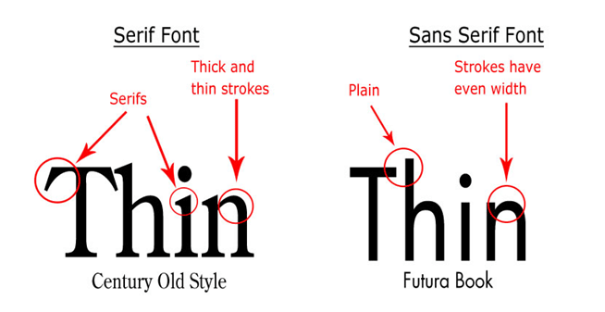
5. Avoid all-capitalized words and phrases.
6. Allow extra white space between lines of text.
7. Be consistent with typefaces, type styles, colour and size.
8. Use serif typefaces with care and only with larger text.

Slide 20
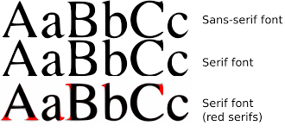
Difference Between Serif and Sans Serif Font

Slide 21
Designing Slides Around A Key Visual
Circular Process
Linear Process
a
b
c
d
a
b
c
With both structured and free form strategies of making slides it is helpful to design slides around a key visual as it facilitates to organize and explain a presenter’s content/points.

Slide 22
Designing Slide Around A Key Visual
Hierarchy
Matrix
Upper Left
Upper Right
Lower Left
Lower Right
Top
Middle
Bottom

